Slide 1
Web-services
Hotel Booking System
By Chang Liu, Li Qian and Qianfeng Sun

Slide 2
Background
The hotel industry faces challenges in managing reservations, availability, and ensuring a seamless booking experience for customers.
Primary purpose of the system:
- streamline the process of reserving rooms
- enhancing efficiency
- customer satisfaction

Slide 3
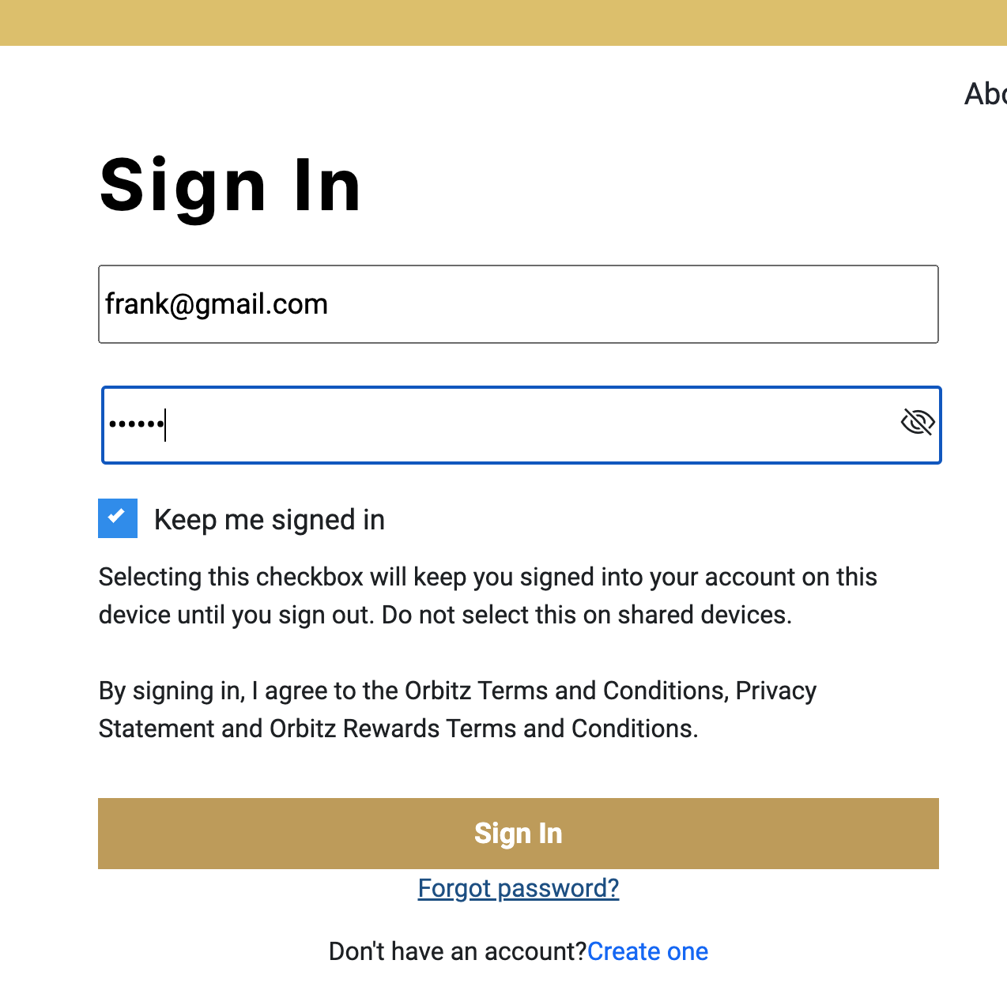
Solution Overview
User Registration/Login and Authentication
User-friendly interface

Slide 4
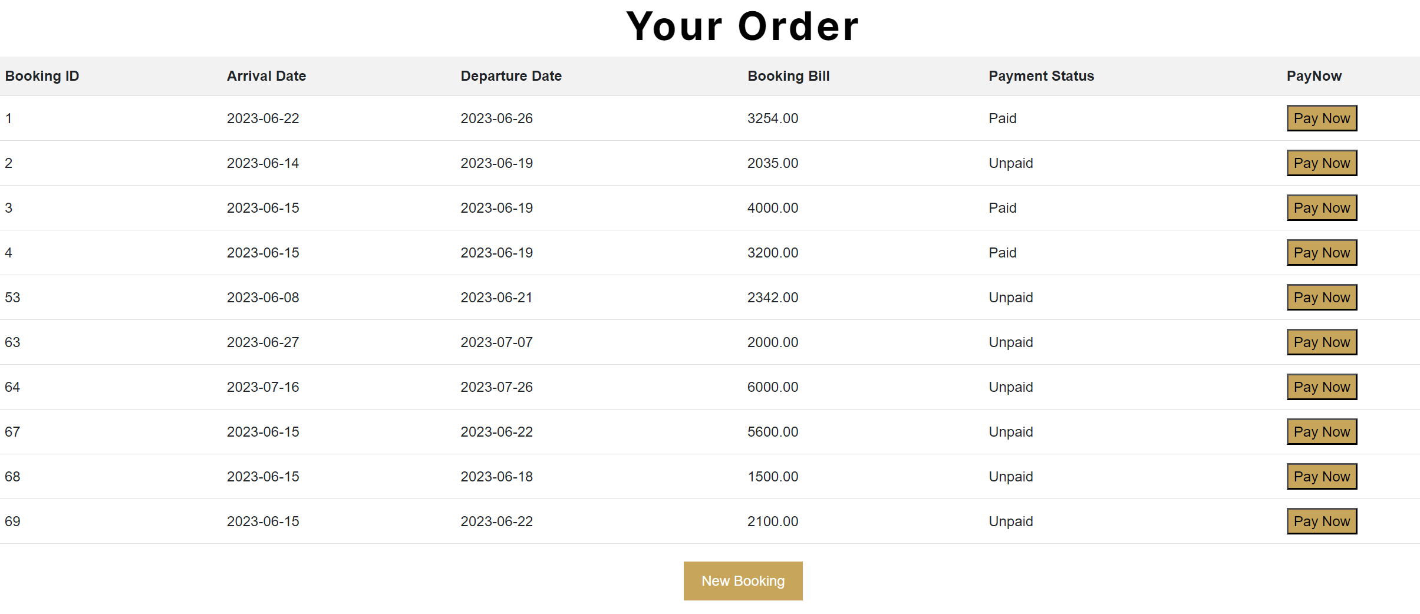
Solution Overview
Booking Management

Slide 5
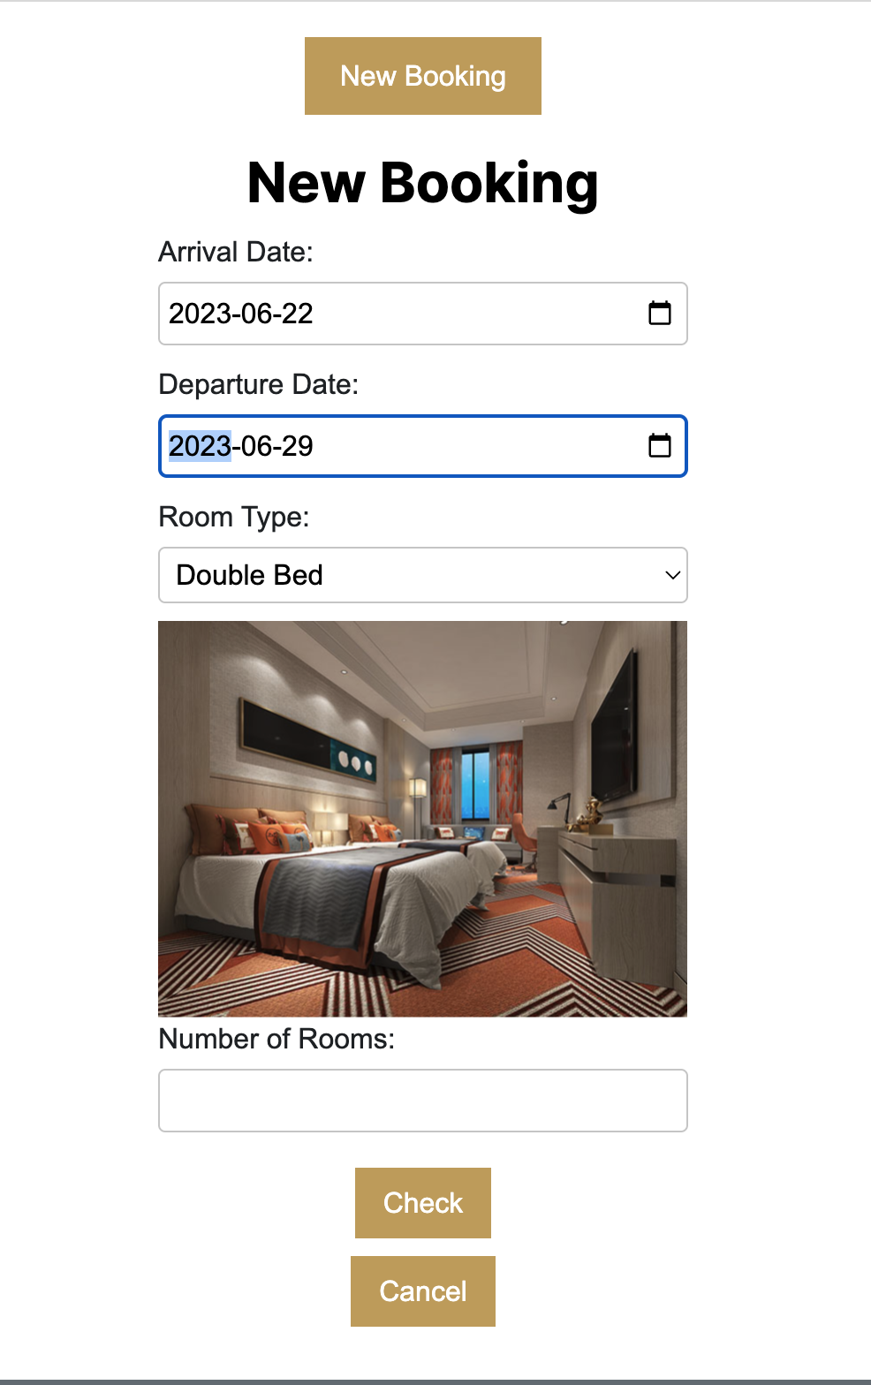
Solution Overview
Real-time Availability

Slide 6
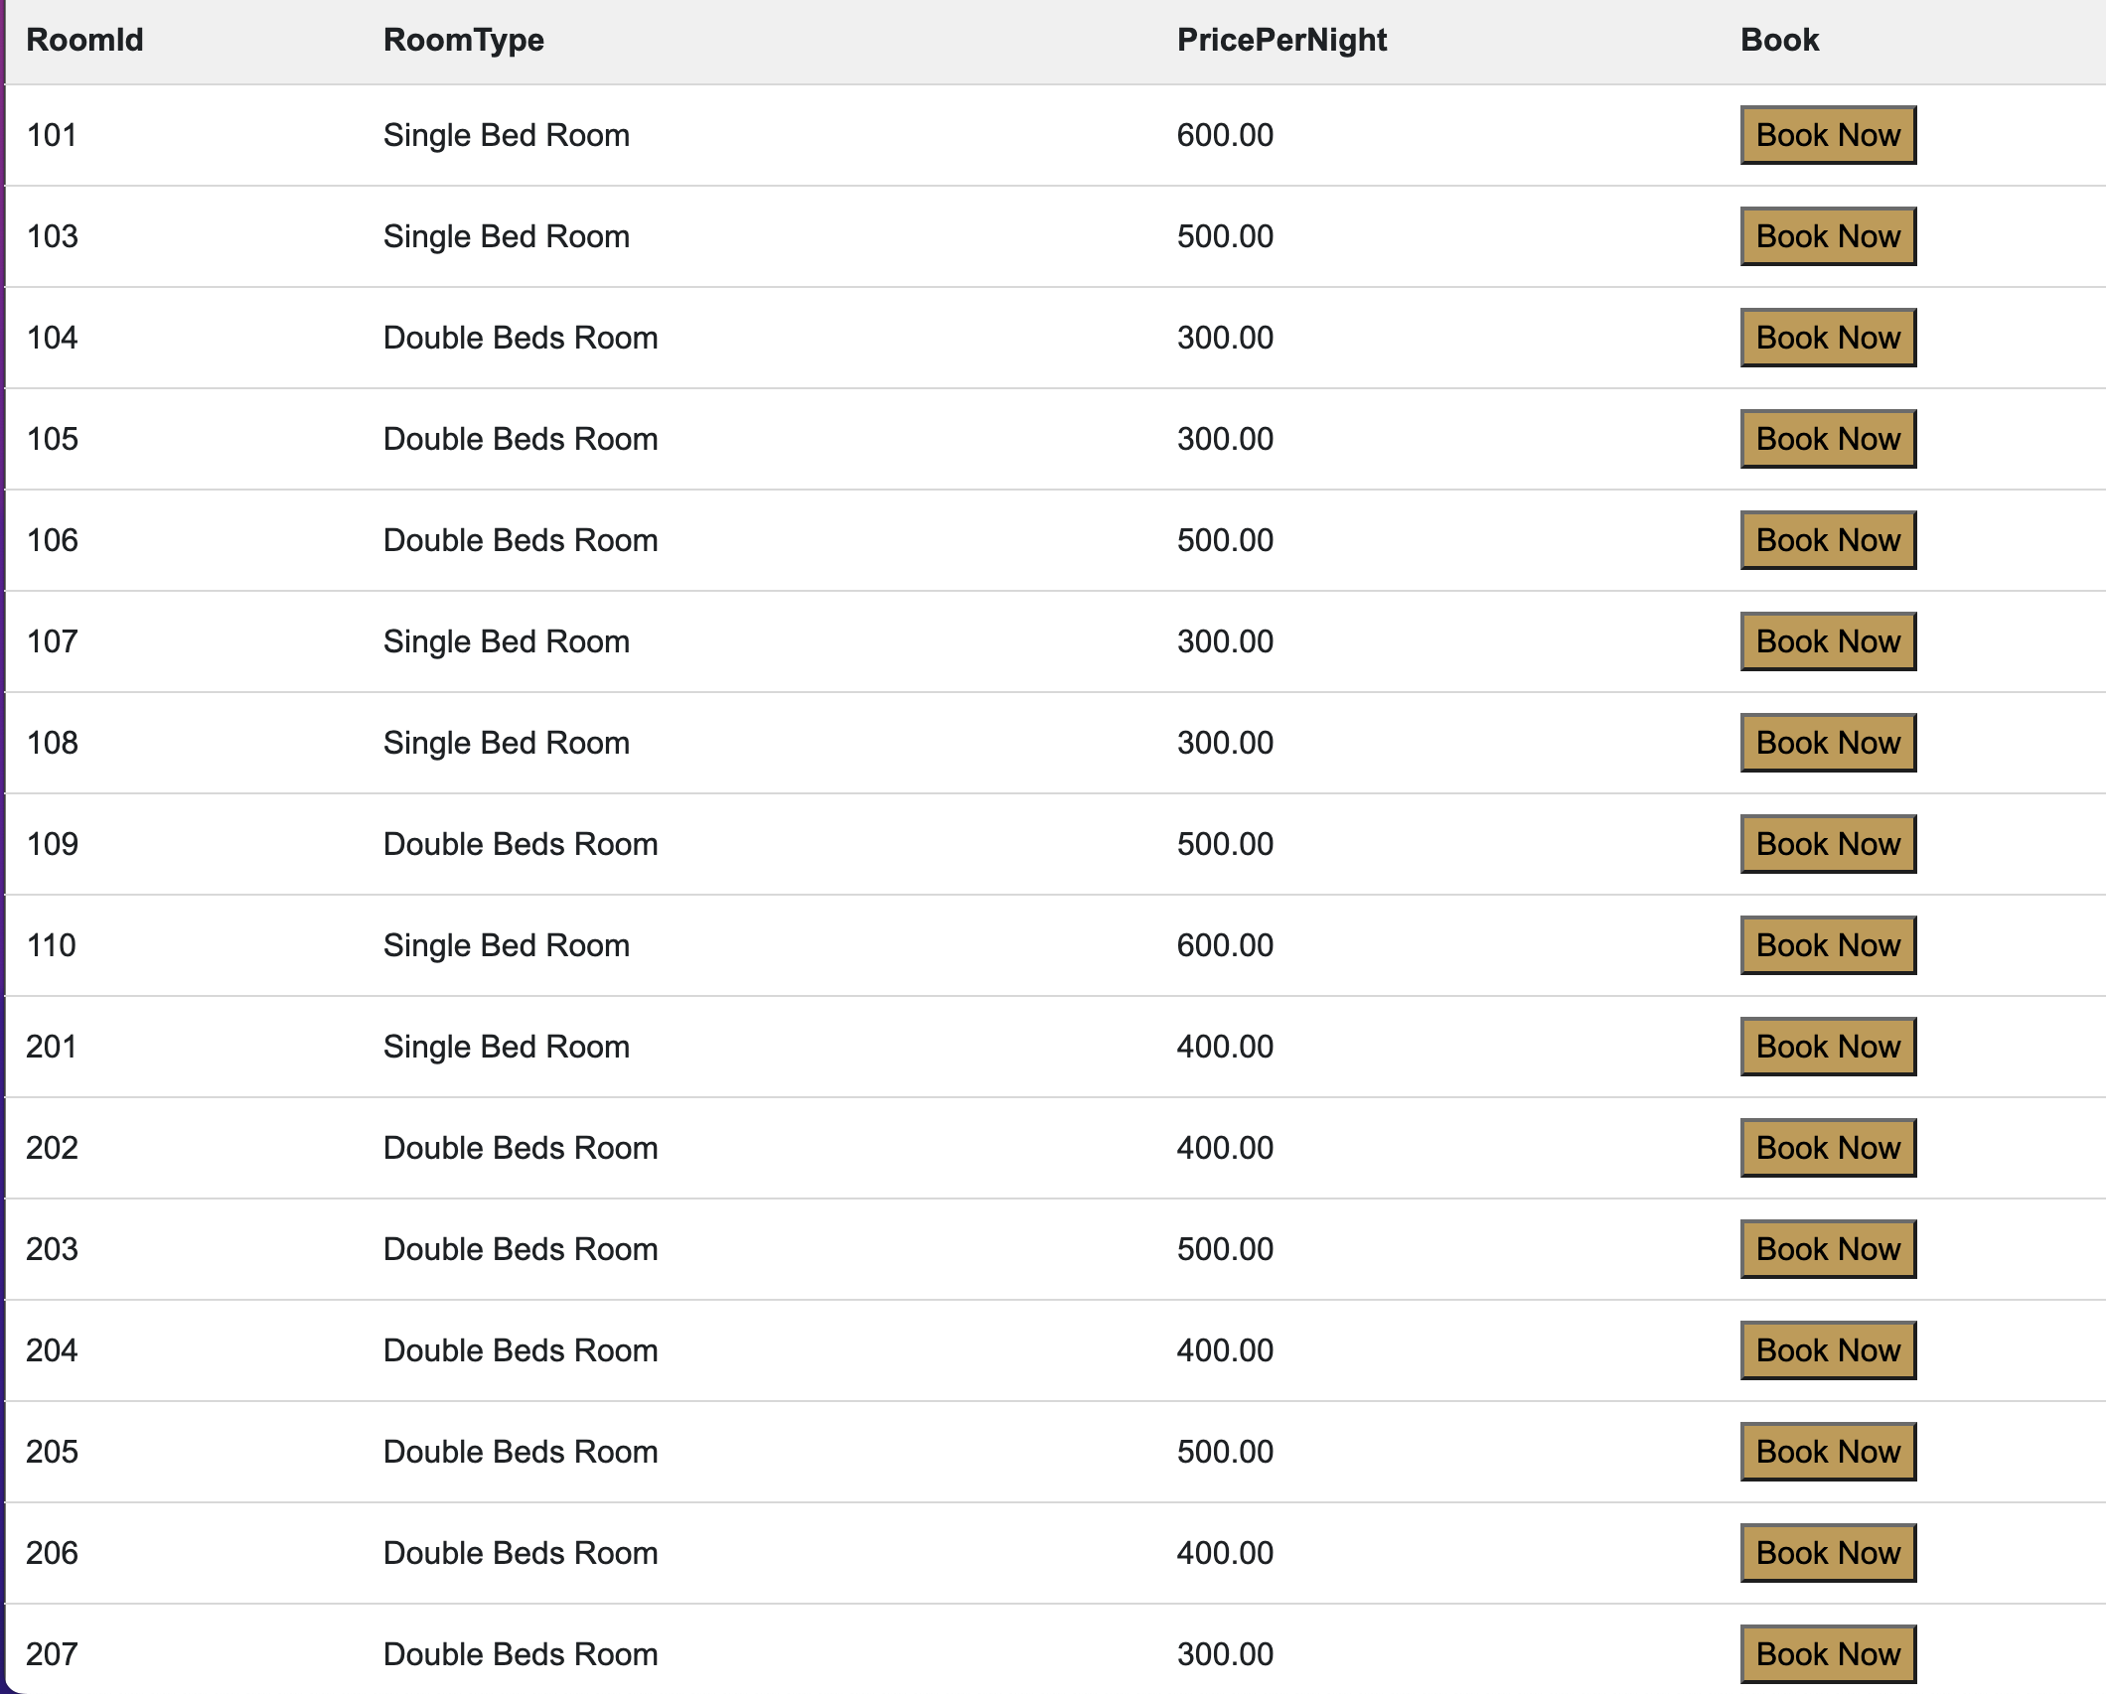
Solution Overview
Easy Search
Booking Process

Slide 7
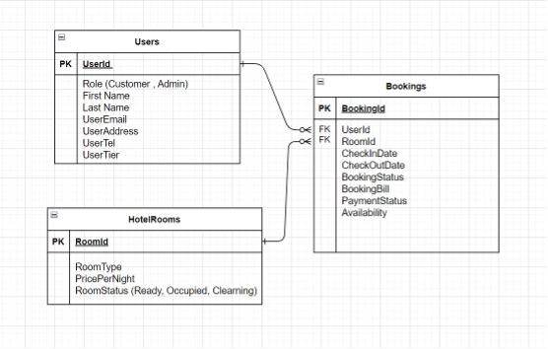
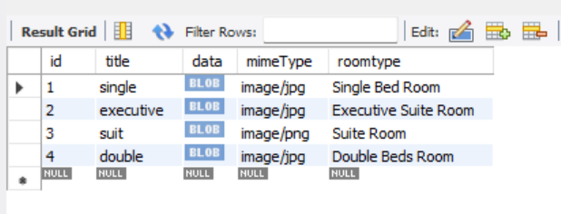
Challenges and Solutions
Bookings Table
Users Table
HotelRooms Table
Efficient storage

Slide 8
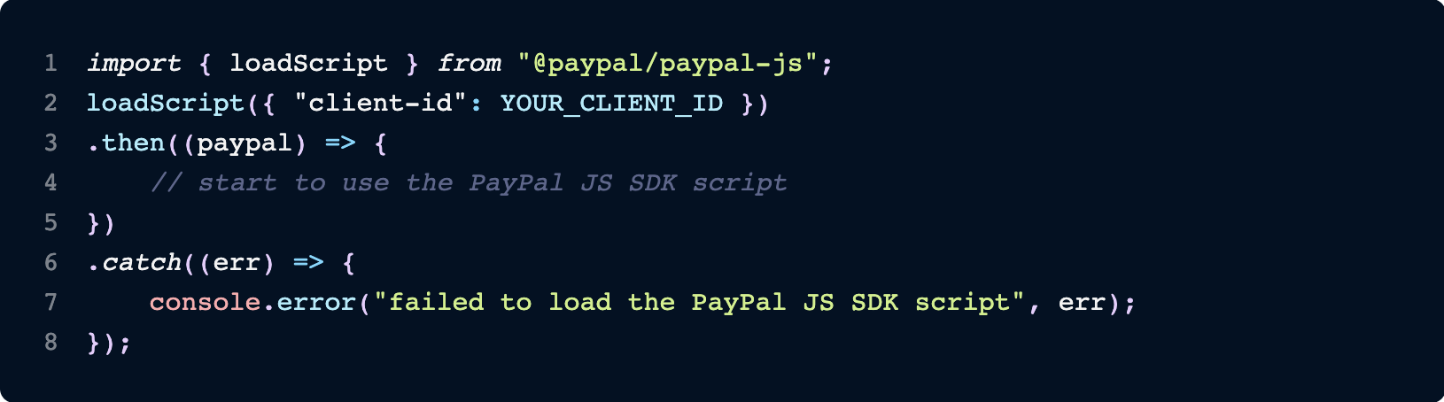
Challenge: Secure Payment Processing
Ensure secure and reliable payment processing for user transactions.
Solution: Integrate secure payment gateway PayPal to handle payment transactions. Utilized encryption techniques and followed best practices for handling sensitive user data.

Slide 9
Challenge: Real-Time Availability Updates
Displaying real-time availability of hotel rooms to users during the booking process.
let queryava = db.format(`select * from hotelrooms where RoomId not in(select RoomId from bookings where (('${chi}'<CheckOutDate AND '${chi}'>CheckInDate) ||('${cho}'<CheckOutDate AND '${cho}'>CheckInDate) || ('${chi}'<CheckInDate AND '${cho}'>CheckOutDate)))`);
Solution: Implemented a real-time database synchronization mechanism to fetch and update room availability status. Ensured accurate and up-to-date availability information for users.

Slide 10
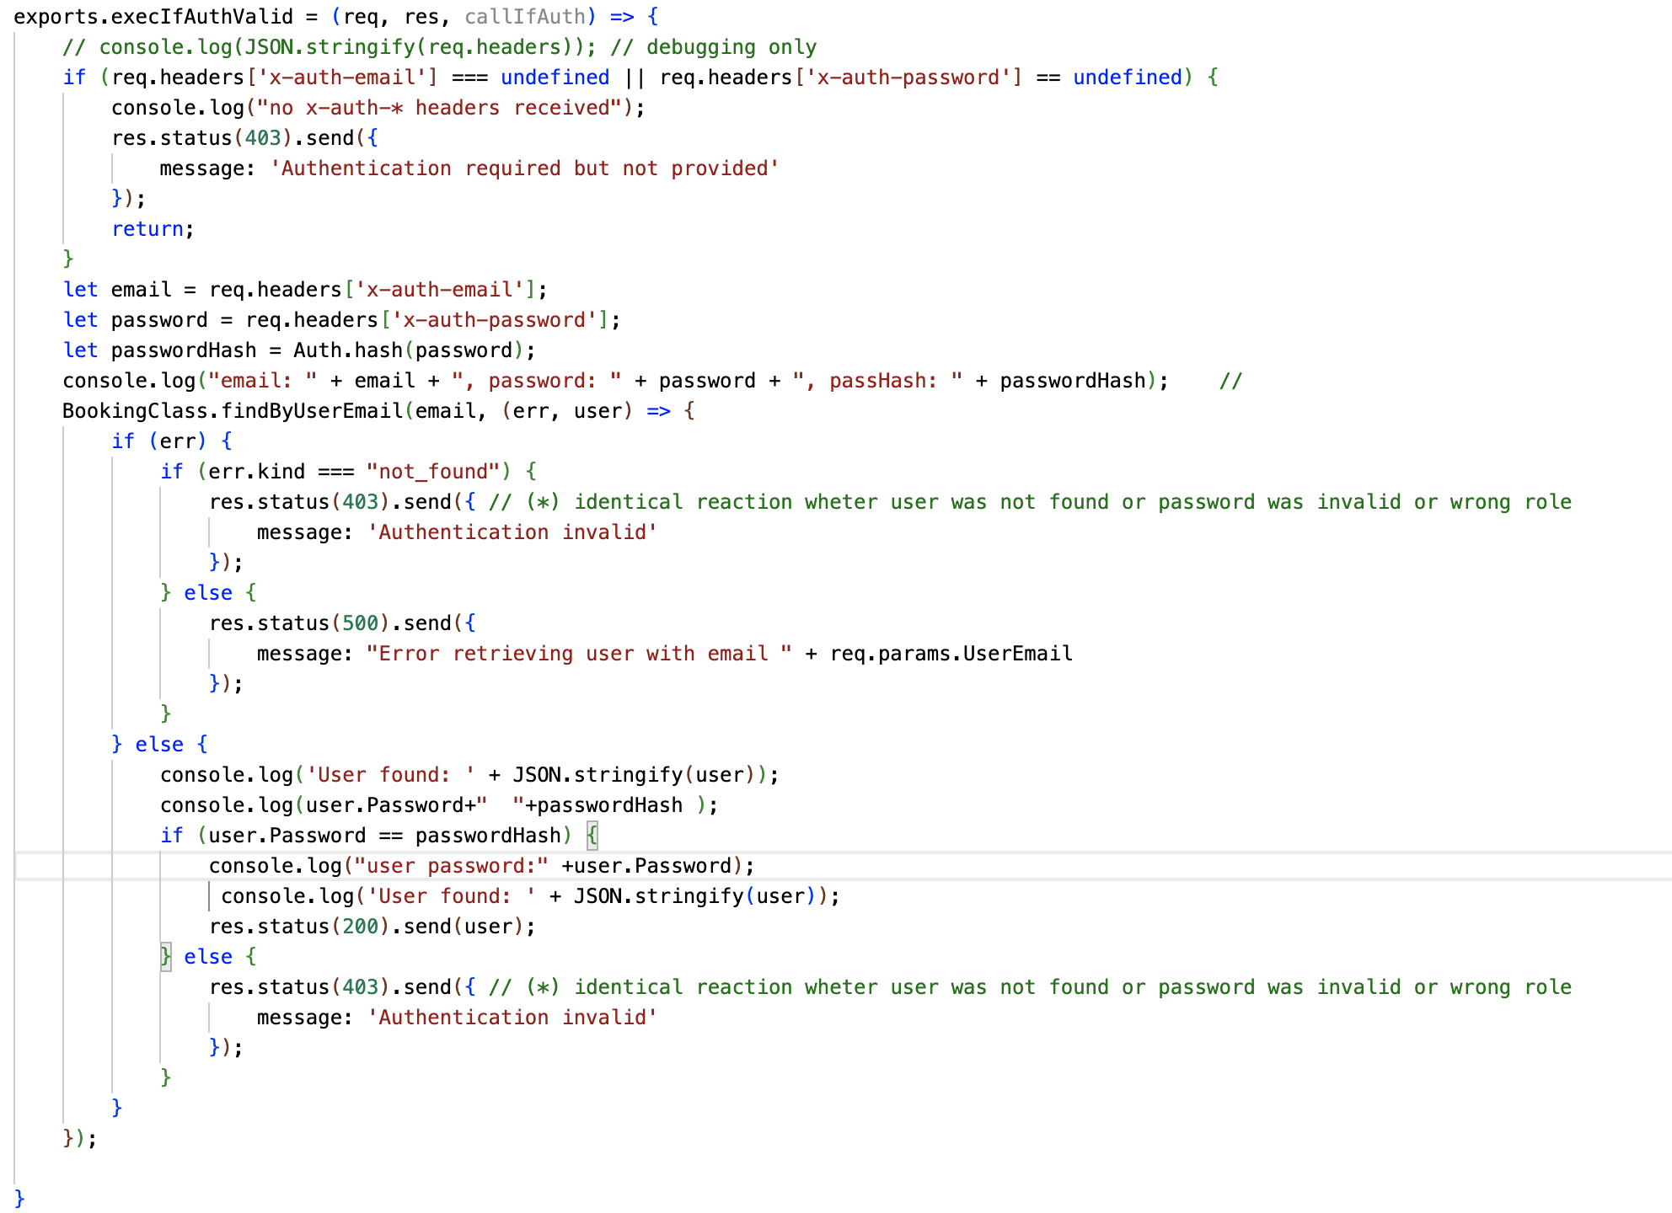
Challenge: User Authentication and Authorization
Implementing a robust authentication and authorization system for user access control.
Solution: Utilized authentication protocols OAuth for secure user authentication.

Slide 11
What we learned about a Modal Popup
It typically displays important information, requires user input, or presents a specific task or choice that needs to be addressed.
Focus on a specific task
Improved user experience
Space efficiency
Visual prominence
Easy customization and integration

Slide 12
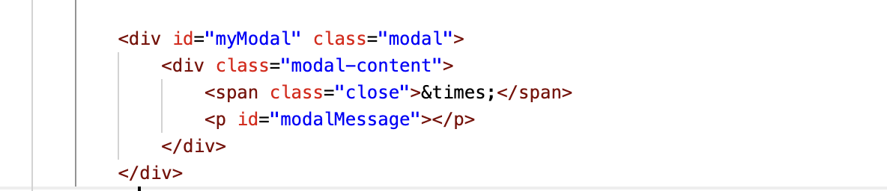
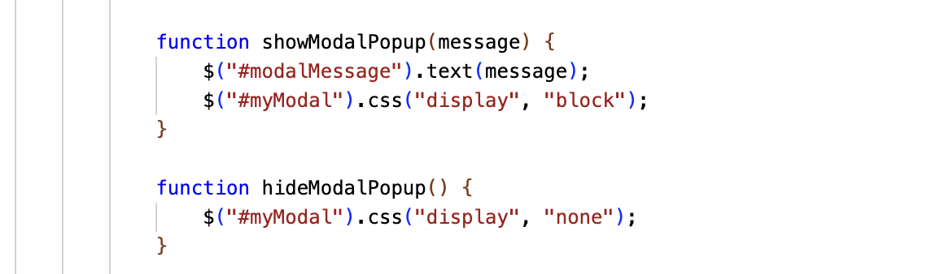
Continued
How to manipulate a modal popup on a web page using jQuery

Slide 13
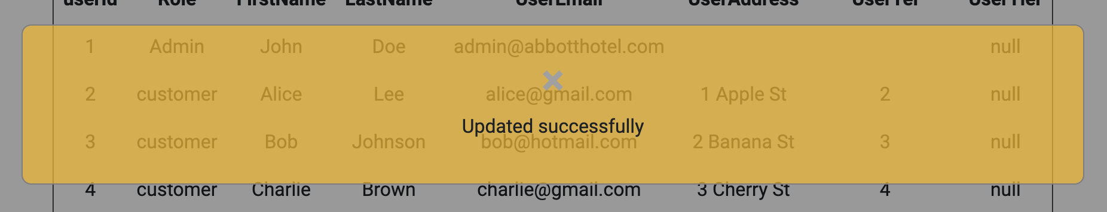
Continued
How to manipulate a modal popup on a web page using jQuery

Slide 14
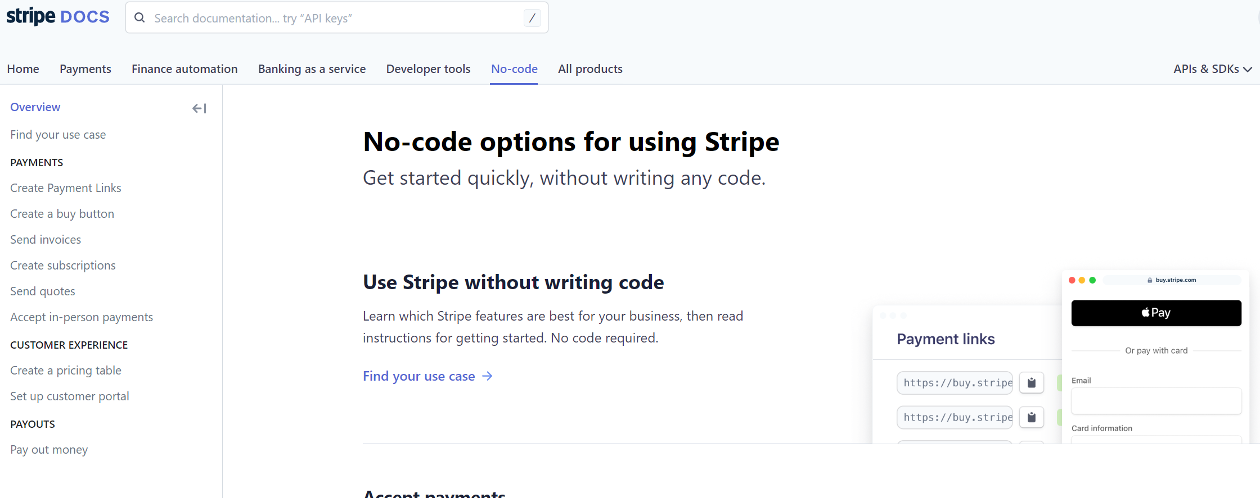
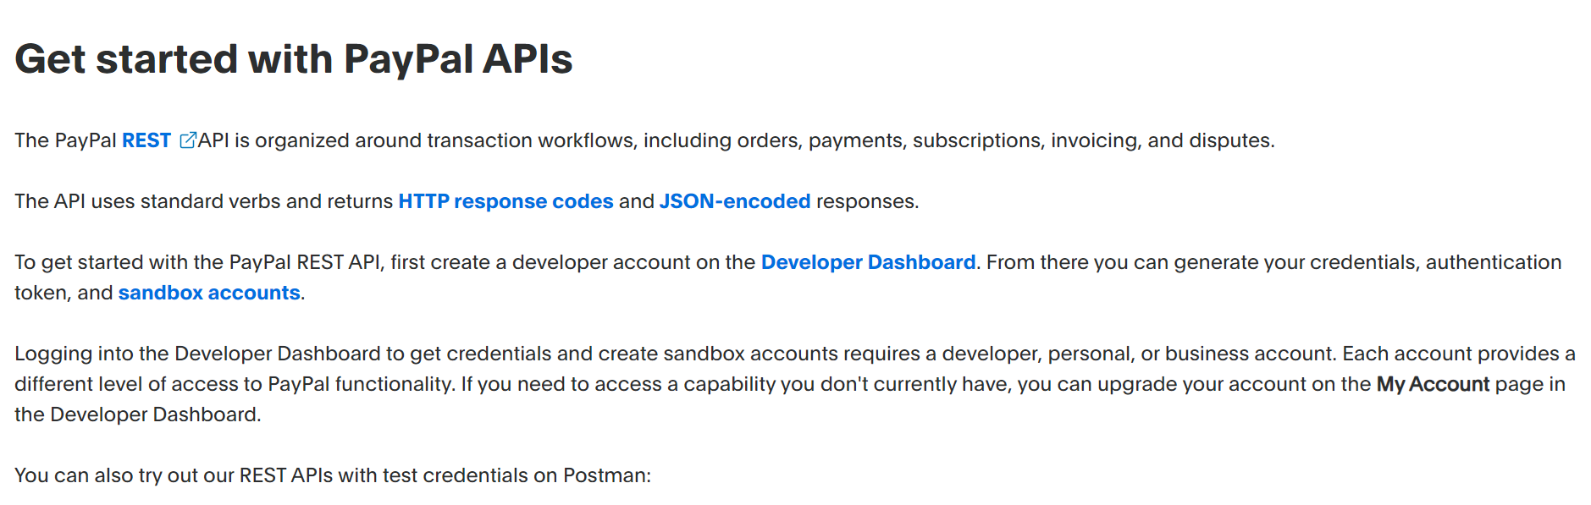
Future Work– Secure Payment Processing
Potential Solutions:
Research and evaluate different payment gateway providers to select a secure and reliable option.
Implement secure communication protocols, such as SSL/TLS, for secure data transmission.
Employ encryption techniques to protect sensitive payment information at rest.

Slide 15

Summary
This project showcased the successful implementation of a hotel booking system using Node.js, providing a seamless user experience and addressing the challenges faced by the hotel industry in managing reservations.

Slide 16

The End Thank you for your time

